Slide 1
Black Panther
Movie review
Gyasi Bawuah
Text mining

Slide 2
Is Black Panther Overhyped? For a technical audience

Slide 3
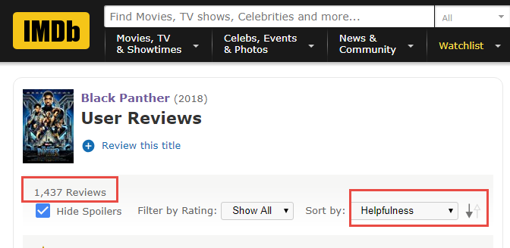
Search Criteria

Slide 4
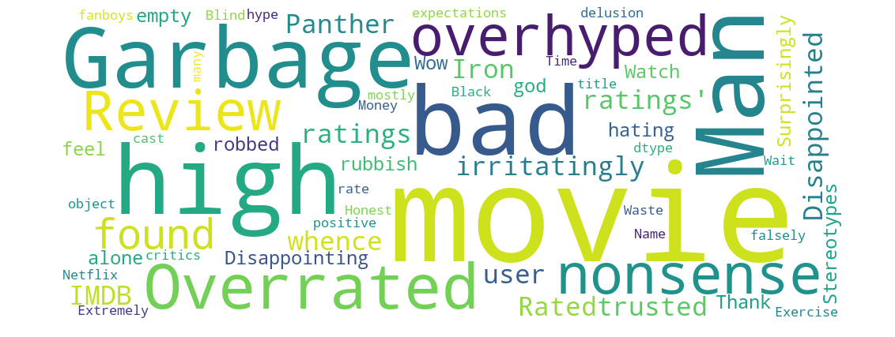
Some themes on IMDB

Slide 5
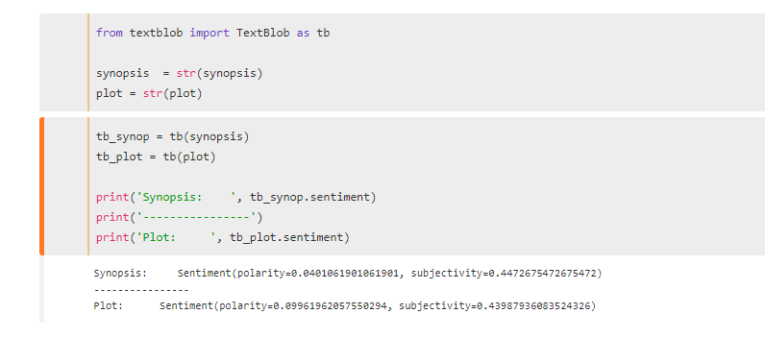
Sentiments of Synopsis and Plot

Slide 6
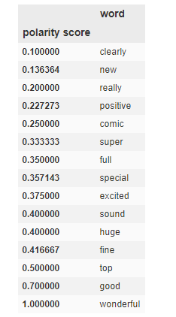
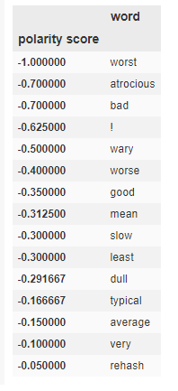
`
WORDNET dictionary:
‘Good’- Misclassification or Contextualization

Slide 7
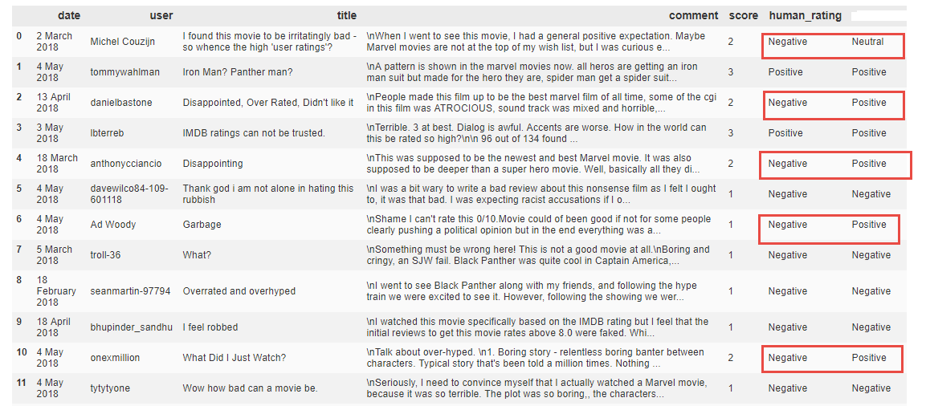
Affin dictionary: reviewing the reviewer

Slide 8
K-Means clustering: Not all Negatives reviews are the same
Cluster | Example 1 | Example 2 | Label
0 | 0- I found this movie to be irritatingly bad - so whence the high 'user ratings'? When I went to see this movie, I had a general positive expectation. Maybe Marvel movies are not at the top of my wish list, but I was curious… | 3- IMDB ratings can not be trusted. Terrible. 3 at best. Dialog is awful. Accents are worse. How in the world can this be rated so high? | Very Negative
1 | 14- Stereotypes Reminds me of "blacksploitation" movies of the 70s. Characters are mostly stereotypes weather Africans or African American. Even the token white. | 15- Surprisingly empty after high expectations High expectations based on media buzz and reviews. After seeing this, I really wonder who would like it. African Americans? Are they not very se.. | Negative
2 | 9- I feel robbed I watched this movie specifically based on the IMDB rating but I feel that the initial reviews to get this movie rates above 8.0 were faked… | 20- All this hype, and for that? Not in the mood to write a huge review. Bottom line, it's just another superhero regurgitation - nothing new or special about it. .. | Critical

Slide 9
Criticism
The sample size has unduly influenced the human rating logic.
The condition is set too low, allowing some negative comments to be classified as positive;
and creating some ‘false’ agreements or consensus between machine rating (AFINN Dictionary) and the User ratings.

Slide 10
Is Black Panther Overhyped?
Based on the data, it is very likely that Black Panther is being overhyped.

